Slide 1
CUPA-HR Quick Site Overview & Resource Guide
Notes:
CUPA-HR offers hundreds of resources that support higher ed HR professionals in their everyday role. In this presentation, we’ll highlight a few of these key resources and show you where to find them.
Let’s start with a quick tour of the CUPA-HR website.

Slide 2
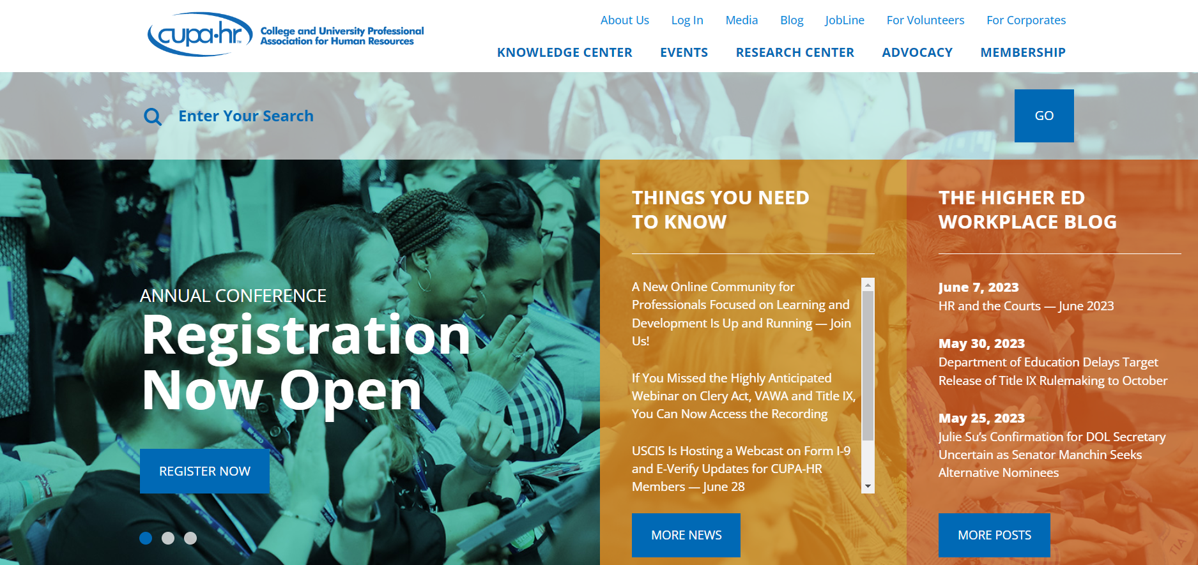
The Knowledge Center houses most of CUPA-HR’s learning resources. These include full length E-learning courses, curated resource collections, and short videos.
E-Learning
Toolkits
Essentials
Resources Pages
Job Description Index
I-9 Consortium
Magazine
Podcasts

Slide 3
The Events page is where you can find upcoming and archived Webinars, CUPA-HR conference information and a full, searchable calendar of national and chapter events.
Webinars
Virtual Workshops
Research Skills Labs
Conferences
Events Calendars
21-Day Challenges

Slide 4
The Research Center houses CUPA-HR’s data resources including annual workforce data, research publications, special surveys, and information and support for our DataOnDemand application.
Research Publications
Workforce Data
Special Surveys
Interactive Graphics
Survey Support
DataOnDemand Support

Slide 5

The Membership page is where you can add individuals to your membership roster, find chapter information and access the Connect forums. You can also find out how to get involved with CUPA-HR here.
Membership Information
Manage Roster
Update Member Profile
Member Directory
Corporate Directory
Member Awards
Chapter Information
Access Connect
Get Involved

Slide 6
Find news and insight pieces on the Blog. You can search current and archived posts by keyword or by using the category menu at the right of the page.
Higher ed HR News
Guest Posts
Legislative News
CUPA-HR News

Slide 7
Quick CUPA-HR Resource & Tool Guide
Annual Workforce Data
Calendar of Events
Connect Forums
Creating Inclusive Communities
Diversity Resources Page
Essentials Videos
Job Description Index
Magazine
Membership Roster
On-Demand Webinars
Research Publications
Special Surveys
Podcasts
Toolkits
Notes:
Now let’s dive a little deeper and highlight some specific resources of interest.

Slide 8
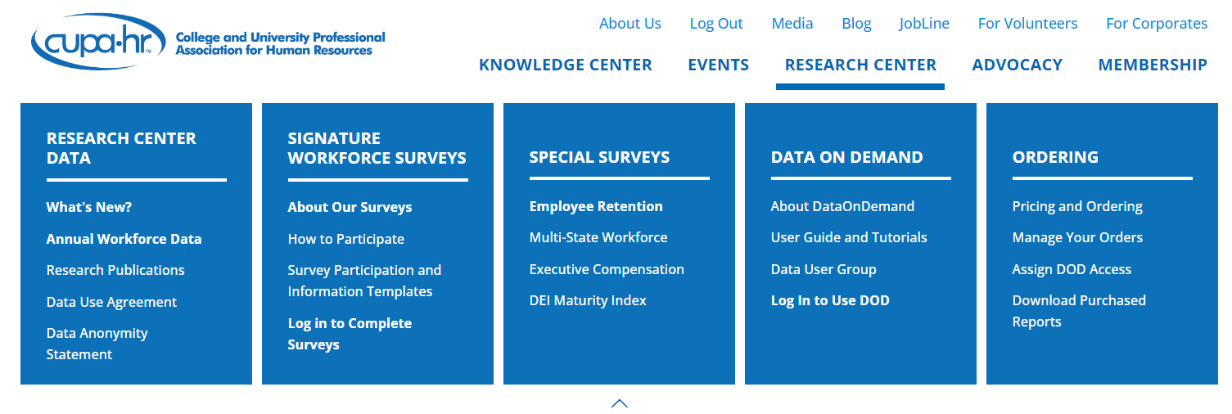
Annual Workforce Data
CUPA-HR’s Annual Workforce Data highlights important findings and trends in higher ed workforce planning, turnover, pay equity, representation and more.
Access through the Main Menu under Research Center.
Back to List

Slide 9
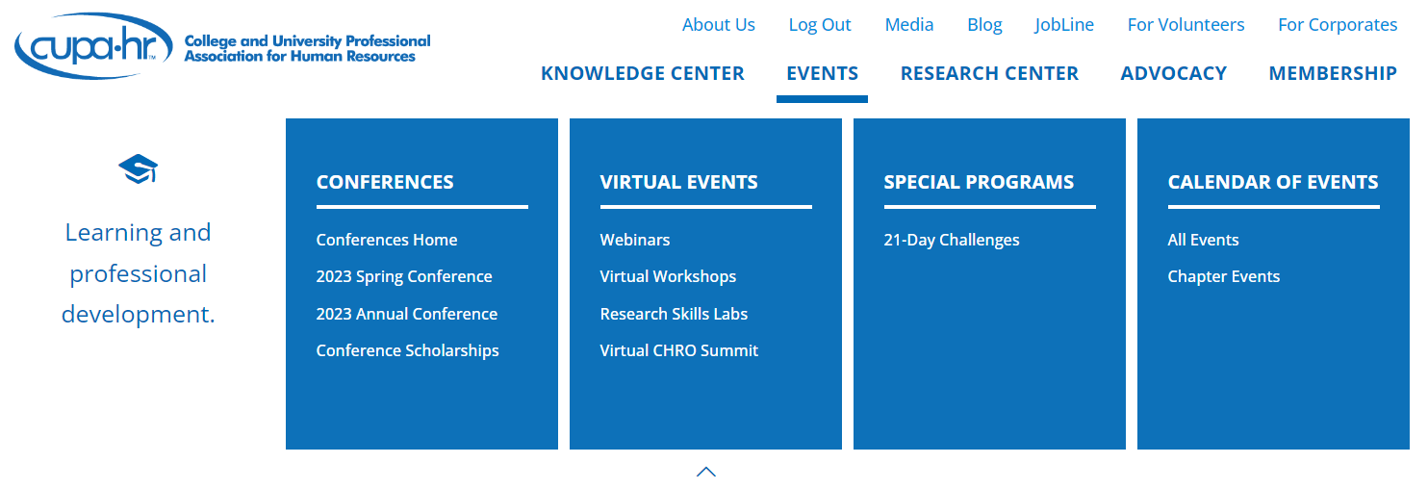
Calendar of Events
Contains all events on the CUPA-HR radar, including webinars, workshops, conferences and chapter events. Filter by event type and navigate to each event’s page for further information and registration. Access from the Main Menu under Events.
Back to List

Slide 10
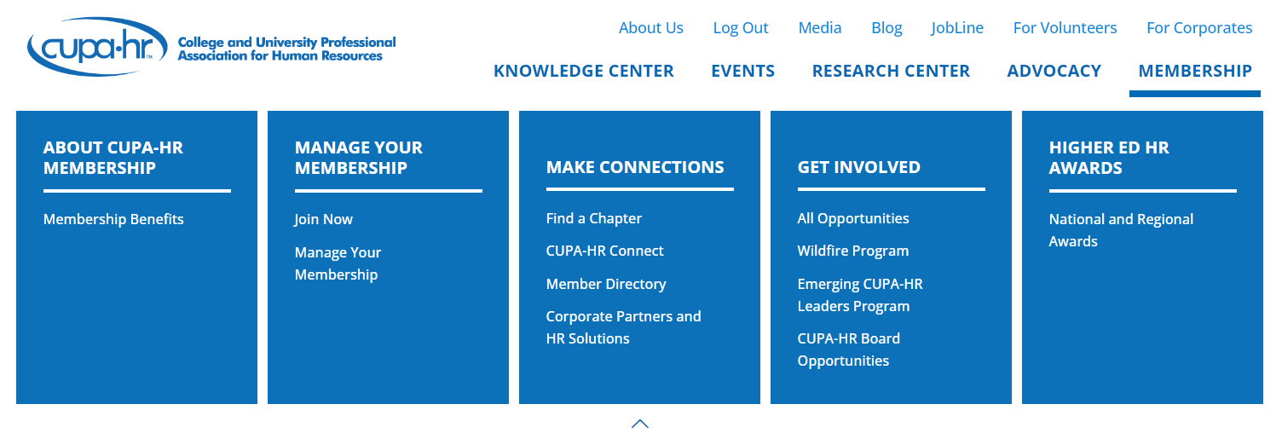
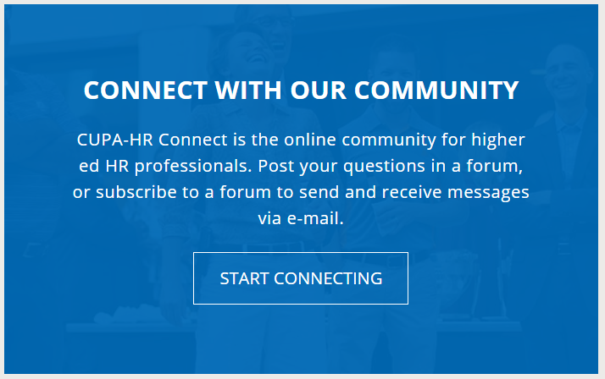
Connect Forums
CUPA-HR Connect puts you in touch with an incredible community of higher ed HR pros. Ask questions, share resources and connect with other higher ed HR practitioners and CUPA-HR members from across the country.
Access through the Main Menu under Membership.
OR
Access by scrolling down on the CUPA-HR Homepage.
Back to List

Slide 11

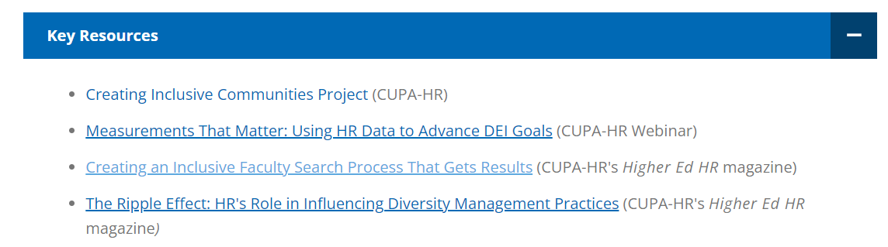
Creating Inclusive Communities
A collection of interviews, photos and videos celebrating some of the unique experiences and perspectives found in the higher ed HR community. The site also includes resources for facilitating discussions on diversity and inclusion.
Access through the Diversity Resources Page under the Involve action
OR
Access through the Diversity, Equity and Inclusion Toolkit under Key Resources
Back to List

Slide 12
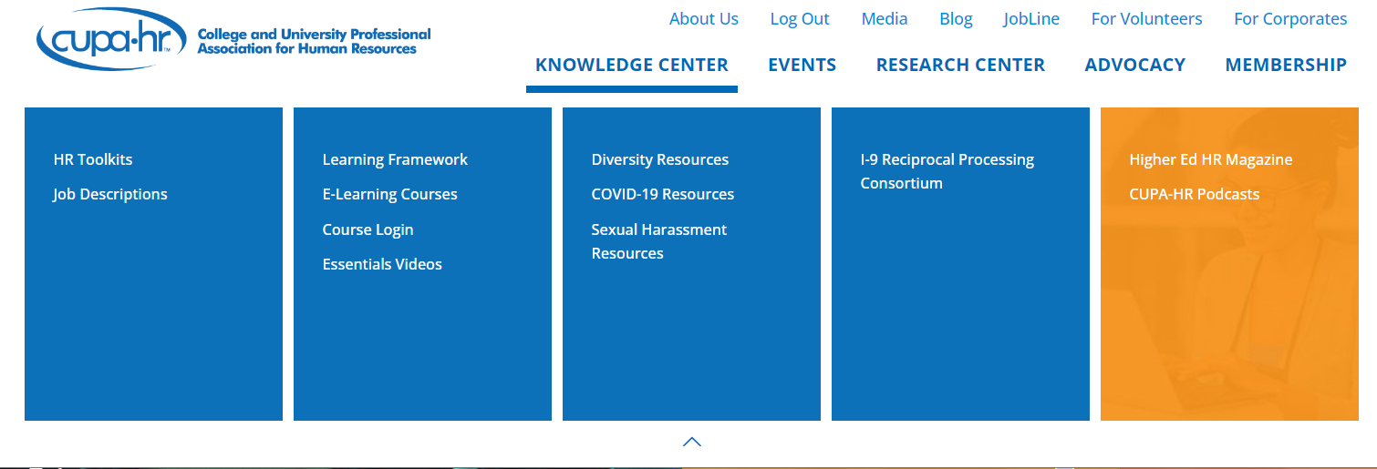
Diversity Resources Page
The Diversity Resources page organizes CUPA-HR’s Diversity resources into four key actions that institutions can take to assess, improve, and sustain their DEI efforts.
Access from the Main Menu under Knowledge Center.
Back to List

Slide 13
Essentials Videos
CUPA-HR’s library of microlearning videos. Running at less than 15 minutes each, these videos provide quick introductions or reviews to essential HR and HE topics.
Access from the Main Menu under Knowledge Center.
Back to List

Slide 14
Job Description Index
The CUPA-HR Job Description Index provides access to institutional examples of job descriptions for positions unique to higher education. All positions are accompanied by a ‘crosswalk’ section with reference codes to aid in the completion of IPEDS and other reporting.
Access through the Main Menu under Knowledge Center.
Back to List

Slide 15

Magazine
Dedicated to all things higher ed workforce-related, the Higher Ed HR Magazine is published three times a year and contains full length articles on higher ed and CUPA-HR news, experiences and opinions.
Access through the Main Menu under Knowledge Center. To explore past issues, go to the magazine home page and select Issues from the Top Menu.
Back to List

Slide 16
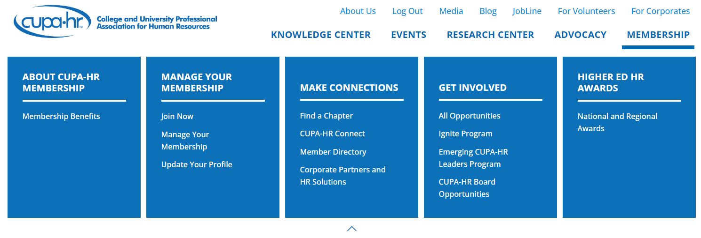
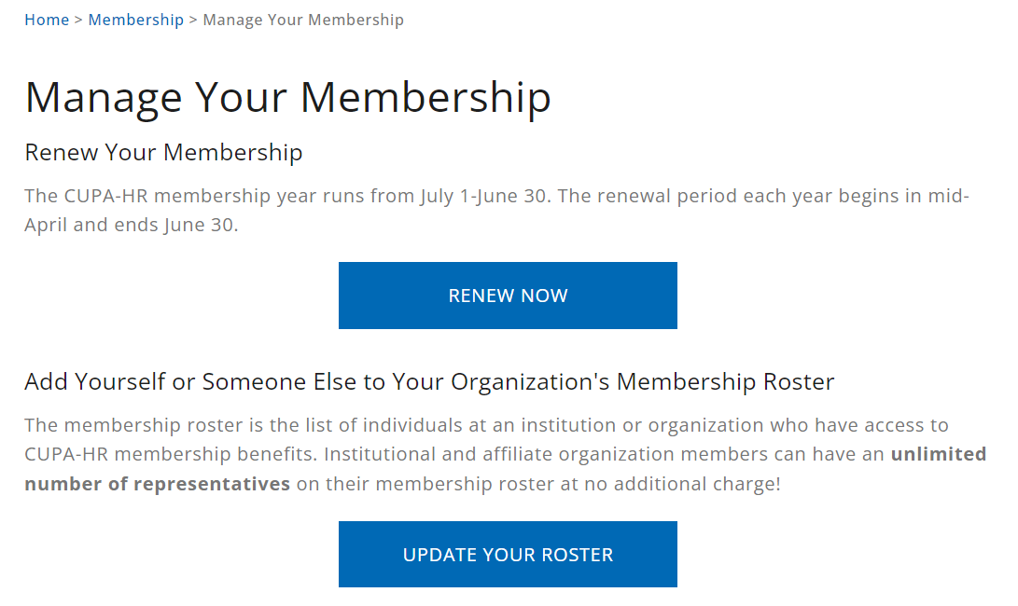
Membership Roster
The membership roster is the list of individuals at an institution or organization who have access to CUPA-HR membership benefits. Institutional and affiliate organization members can have an unlimited number of representatives on their membership roster at no additional charge.
Access through the Main Menu under Membership. Once on the Membership Page, click the Update Your Roster button.
Back to List

Slide 17
On-Demand Webinars
Recordings of past CUPA-HR webinars allow for on-demand learning that fits members’ schedules.
Access through the Main Menu under Events.
Select Webinars and scroll down to see available on-demand webinars from the current and past years.
Back to List

Slide 18

Podcasts
Listen the advice and experience of your CUPA-HR peers in these interview style podcasts on career and mental health. Access through the Main Menu under the Knowledge Center. Podcasts can also be found on Google Play Music, Apple Podcasts, and Spotify by searching CUPA-HR.
Back to List

Slide 19
Research Publications
CUPA-HR’s Research Publications allow members to explore key higher ed data through interactive graphics, important findings, and recommended actions
Access through the Main Menu under Research Center.
Back to List

Slide 20
Special Surveys
CUPA-HR’s Special Surveys are surveys conducted on critical and timely higher ed topics such as Employee Retention and the Multi-State Workforce.
Access through the Main Menu under Research Center.
Back to List

Slide 21
Toolkits
Toolkits provide a brief introduction to an HR topic and contain tools such as sample policies, forms and templates, how-to guidance and links to further resources that helps support the busy HR practitioner in their day-to-day jobs.
Access through the Main Menu under Knowledge Center.
Back to List

